Slide 1
Death and healthcare statistics
Prepared by Edita Komarova and Džiugas Pečiulevičius

Slide 2
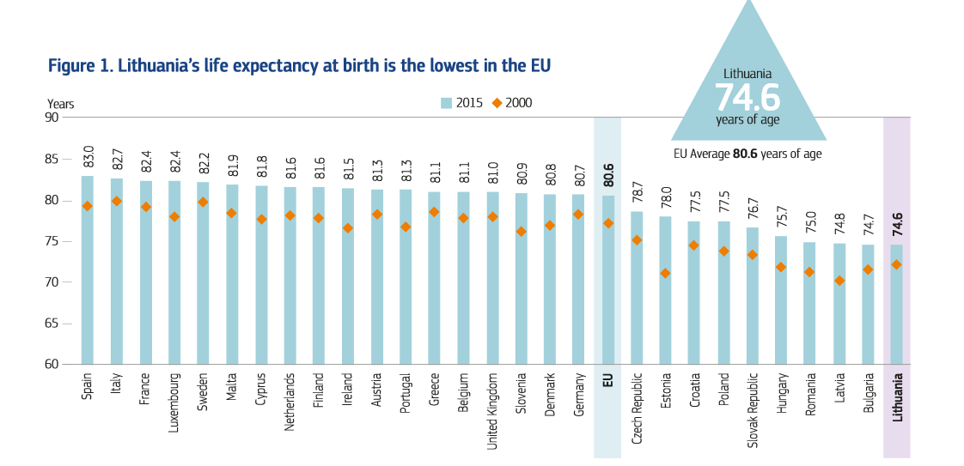
Life Expectancy in Lithuania

Slide 3
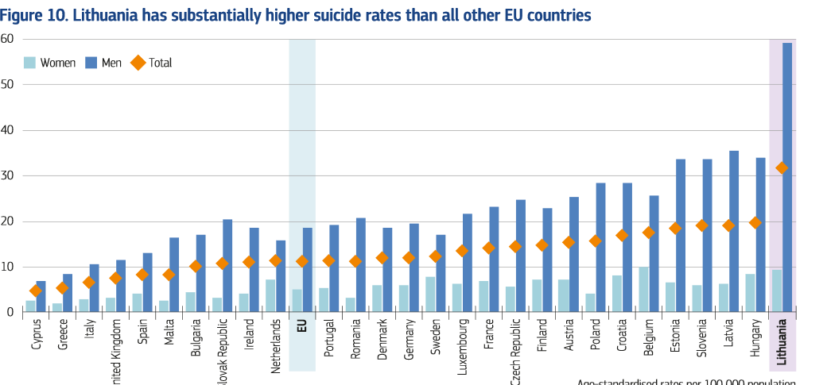
Suicide rates

Slide 4
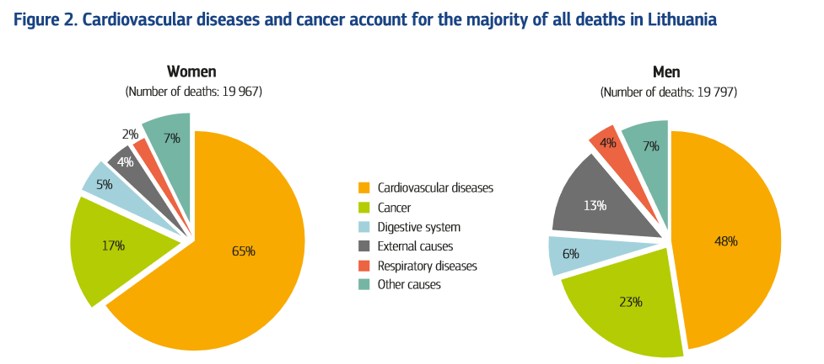
Reason of deaths in Lithuania

Slide 5
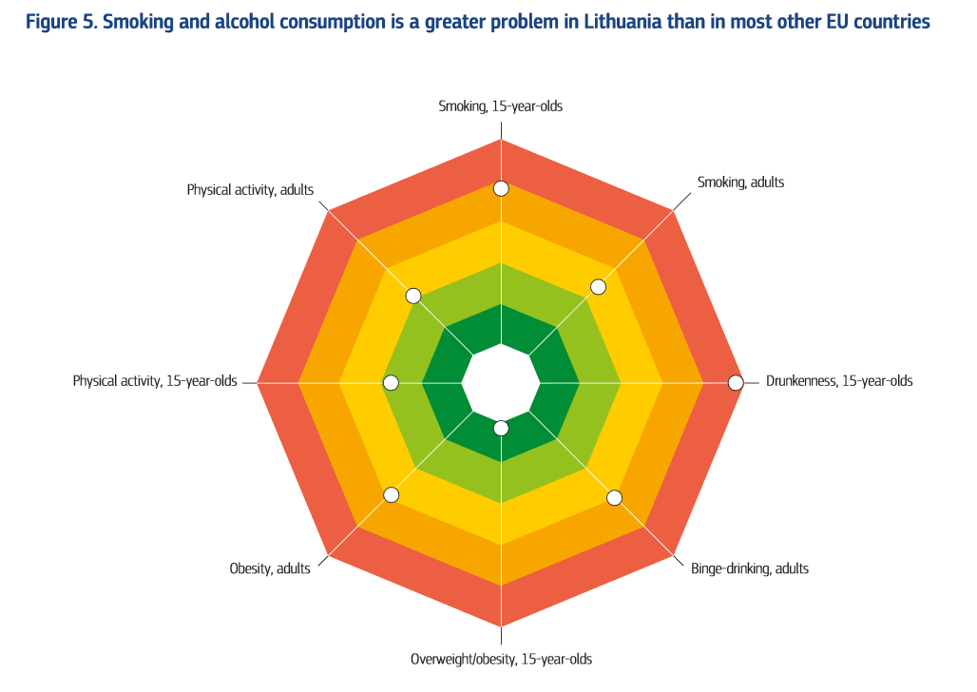
Smoking and alcohol consumption

Slide 6
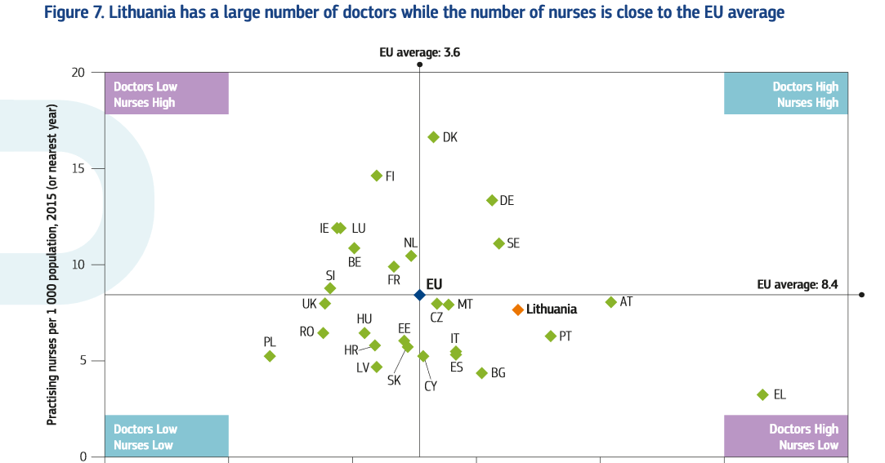
Medical staff number comparison to EU contries

Slide 7
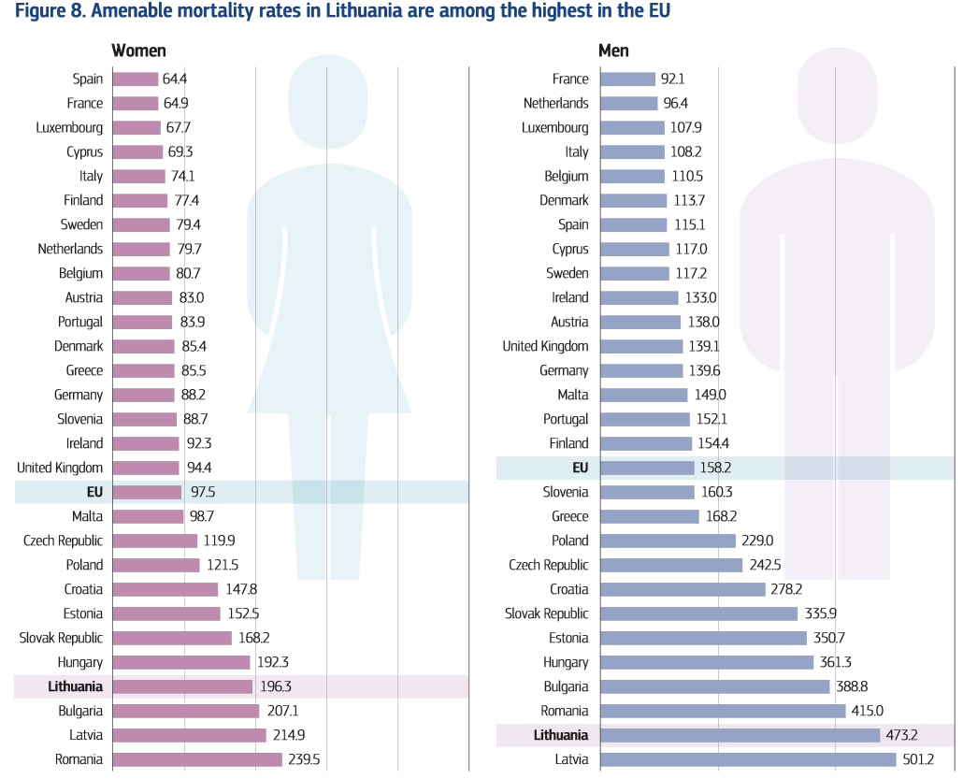
The effectiveness of treatment

